Slide 1
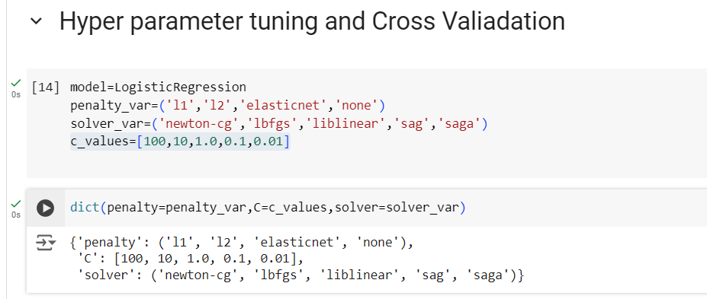
Different Hyper parameters
Generate the value as Key value pair

Slide 2
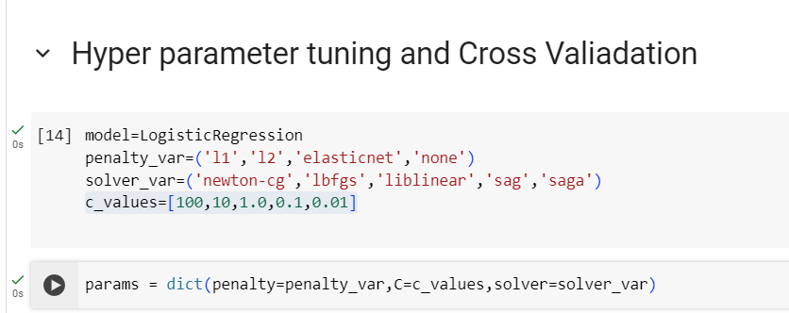

Slide 3
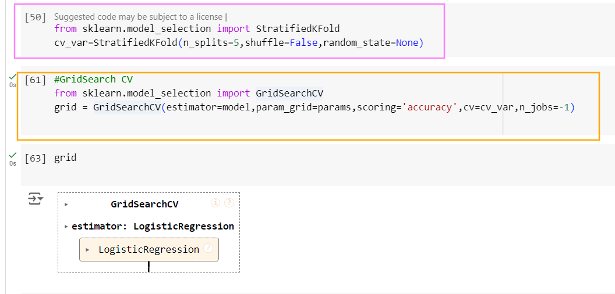

Slide 4
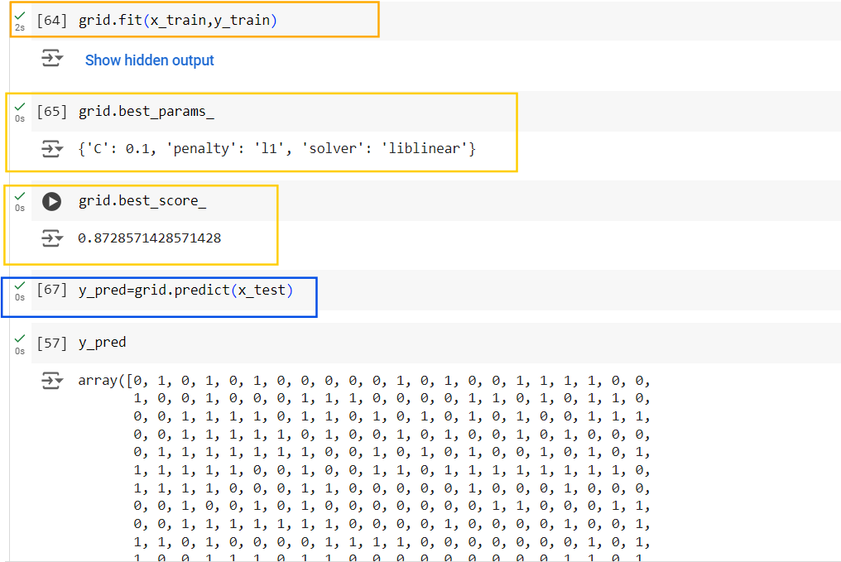
Hyperparameters that produced the best cross-validated performance score during the grid search process.

Slide 5
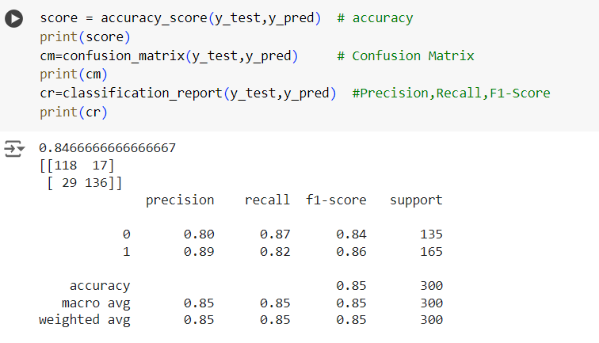
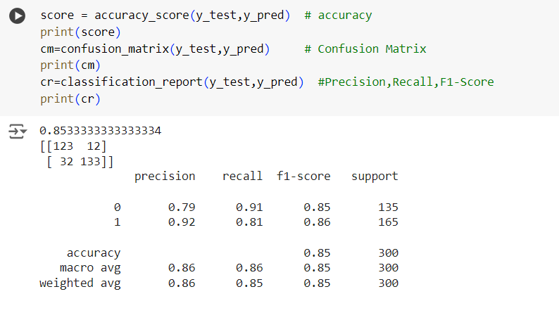
Before Hyperparameter Tuning
After Grid search Hyperparameter Tuning

Slide 6
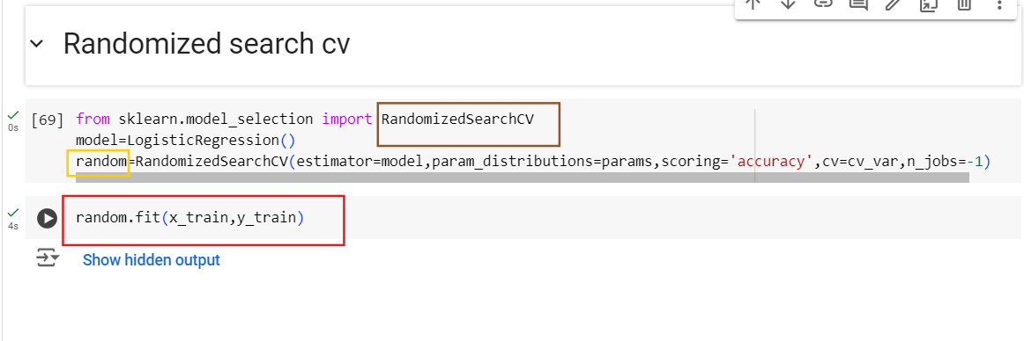
Use the same Hyperparameters we used for Grid Search CV

Slide 7
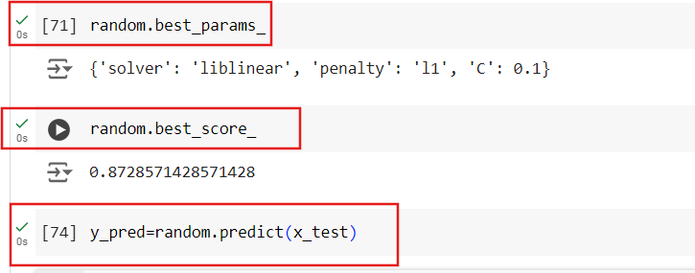

Slide 8
